Slide 1



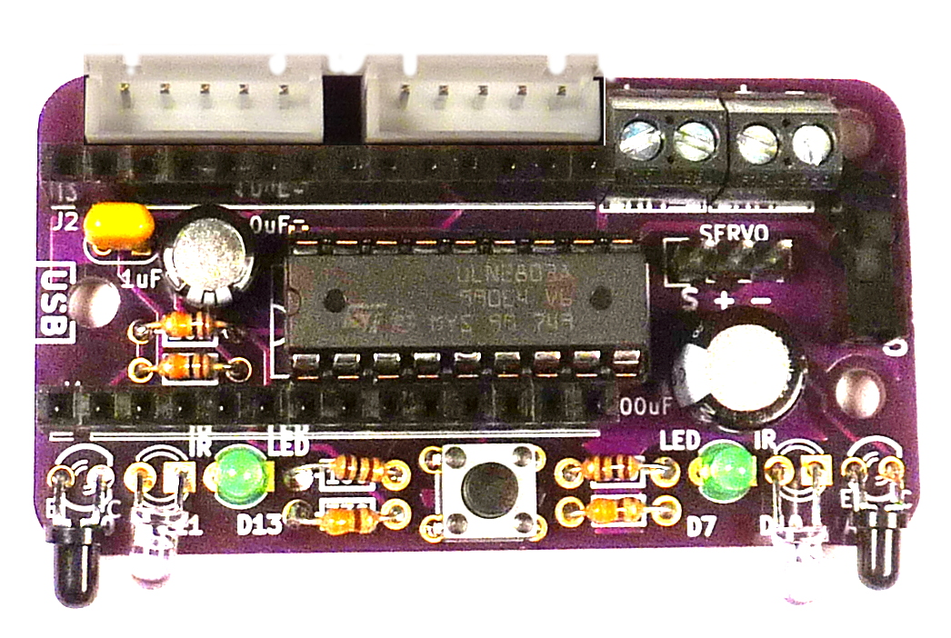
Turtle Robot Board Assembly (V2)
Assemble in order indicated.
1. Resistors:
No polarity
100 ohm = brown-blackk-brown-gold
330 ohm = orange-orange-brown-gold
10K ohm = brown-black-orange-gold
7. Headers:
White JST: Slots outward
Black 2-position: Openings outward
Servo 3-position: long legs up
2. IC socket:
Match divot on left side.
Insert chip after Step 7.
6.Switch:
No polarity
3. Button:
Match legs to holes
Press to snap in place
4. LEDS / IR / Detector:
LED (D13, D7): long leg is positive. Square Pad
Bend IR emitter & detector so they face the front:
  Clear IR Emitter (D11, D10): long leg is positive. Square Pad
  Black IR Detector (A0, A1): Long leg emmiter (“E”).
5. Capacitors:
1 uF no polarity “104”
10 uF long leg positive
100 uF long leg positive

